Slide 1
The Dual Output Register File
module RegisterFile( Clk, Rst, W_en, W_Addr, W_Data, Ra_Addr, Rb_Addr, Ra_en, Rb_en, Ra_Data, Rb_Data );
input Clk; // system clock
input Rst; // system reset
input W_en; // write enable
input [3:0] W_Addr; // write address
input [15:0] W_Data; // data to write
input [3:0] Ra_Addr, Rb_Addr; // A side and B side read addresses
input Ra_en, Rb_en; // A side and B side read enables
output [15:0] Ra_Data, Rb_Data; // A side and B side outputs (switched)
output [15:0] RQ0; // Register 0 output (unswitched)
wire [15:0] Ra_d , Rb_d; // read enables (decoder outputs)
wire [15:0] W_d ; // write enable (decoder output)
genvar I; // we are going to generate the registers
// instantiate two read decoders and a write decoder
GenericDecoder #(.M(4)) WriteDecoder( W_Addr, W_en, W_d ); // write decoder
GenericDecoder #(.M(4)) ReadADecoder( Ra_Addr, Ra_en, Ra_d ); // A side read decoder
GenericDecoder #(.M(4)) ReadBDecoder( Rb_Addr, Rb_en, Rb_d ); // B side read decoder
// instantiate the 16 dual-output registers
generate
for ( I=0; I<16; I=I+1 ) begin:rgen
RegisterDualOE U( Clk, Rst, W_d[I], W_Data, Ra_d[I], Rb_d[I], Ra_Data, Rb_Data );
end
endgenerate
endmodule

Slide 2
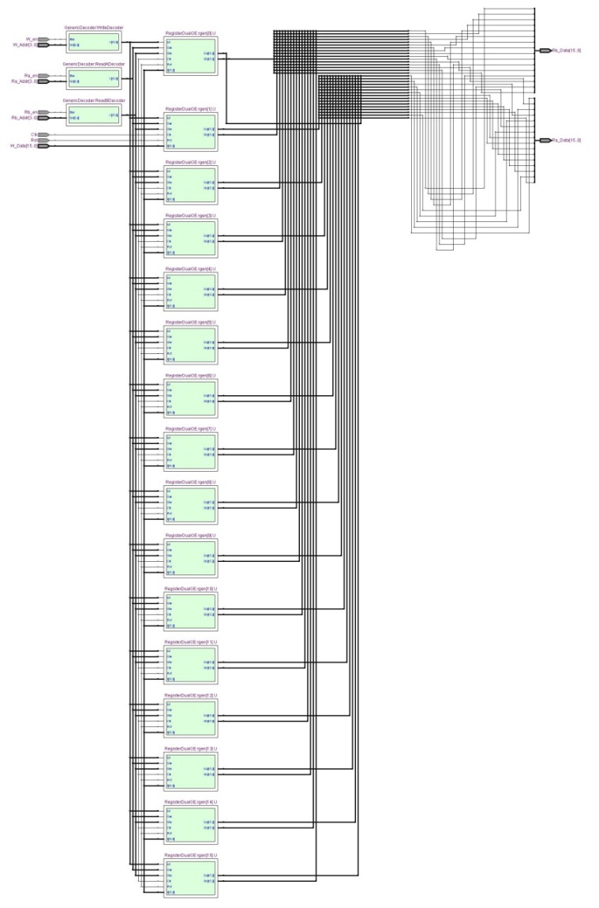
Register File with Dual Outputs

Slide 3
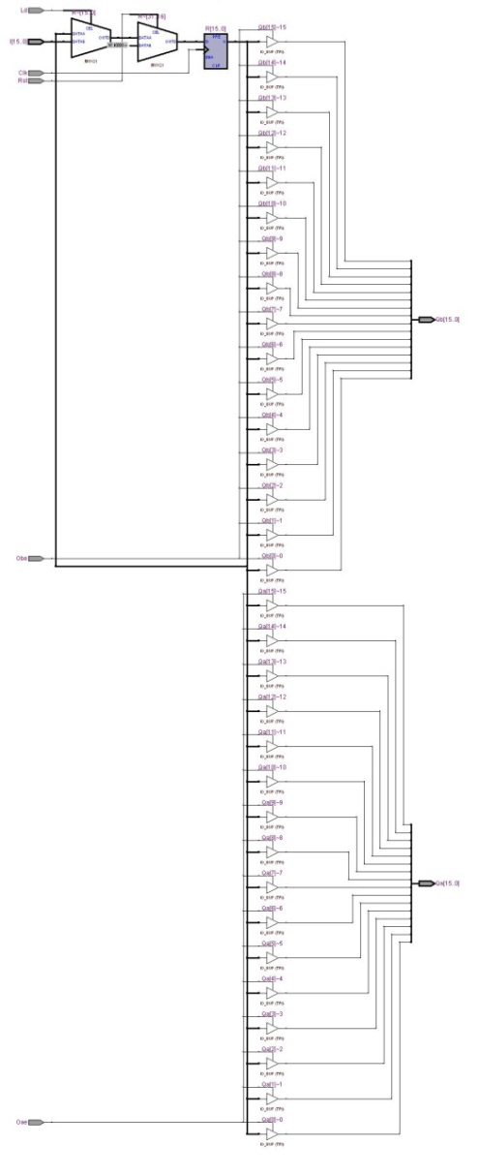
RegisterDualOE

